Slide 1
Building Responsible AI: Fairness, Privacy, and Compliance in Machine Learning Datasets
Insights from Nature Machine Intelligence Study
POOJA SINGH
CMPE-255,SJSU

Slide 2
Why Responsible Datasets Matter
AI systems depend on data for training, and poor datasets can lead to:
Bias: Facial recognition misidentifying dark-skinned individuals.
Privacy Violations: Medical datasets exposing patient information.
Non-Compliance: Legal consequences under GDPR and HIPAA.
Key Point: Ethical, inclusive, and compliant datasets are essential for building trustworthy AI.

Slide 3
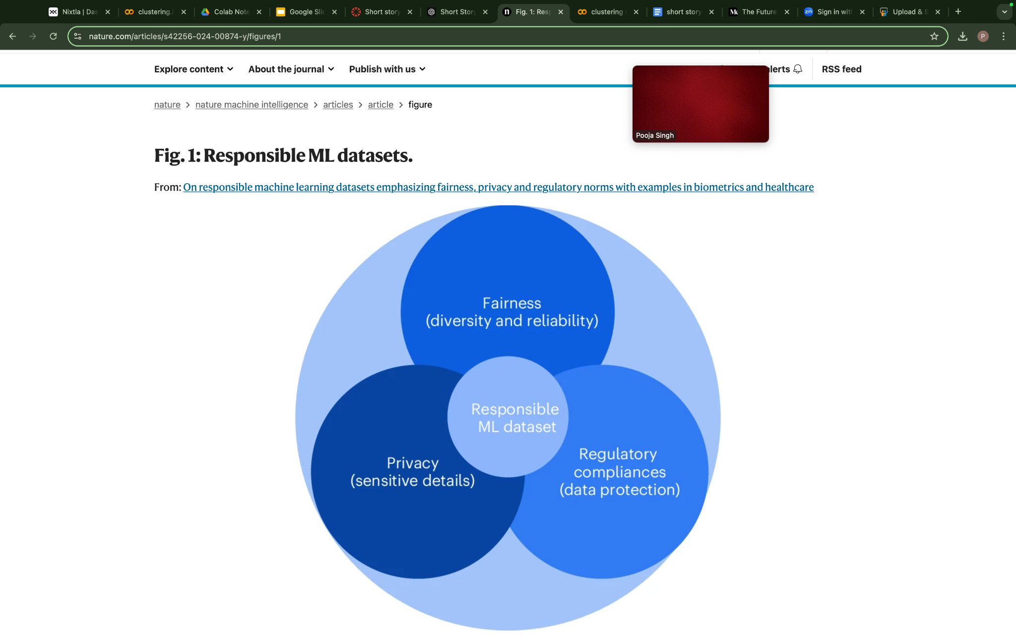
Key Dimensions of Responsibility
Fairness: Inclusivity and diversity in demographic representation.
Privacy: Protecting sensitive data like medical conditions or personal identifiers.
Regulatory Compliance: Aligning datasets with GDPR, HIPAA, and other laws.
This Venn diagram illustrates the three core dimensions—Fairness, Privacy, and Compliance—that define a Responsible ML Dataset.

Slide 4
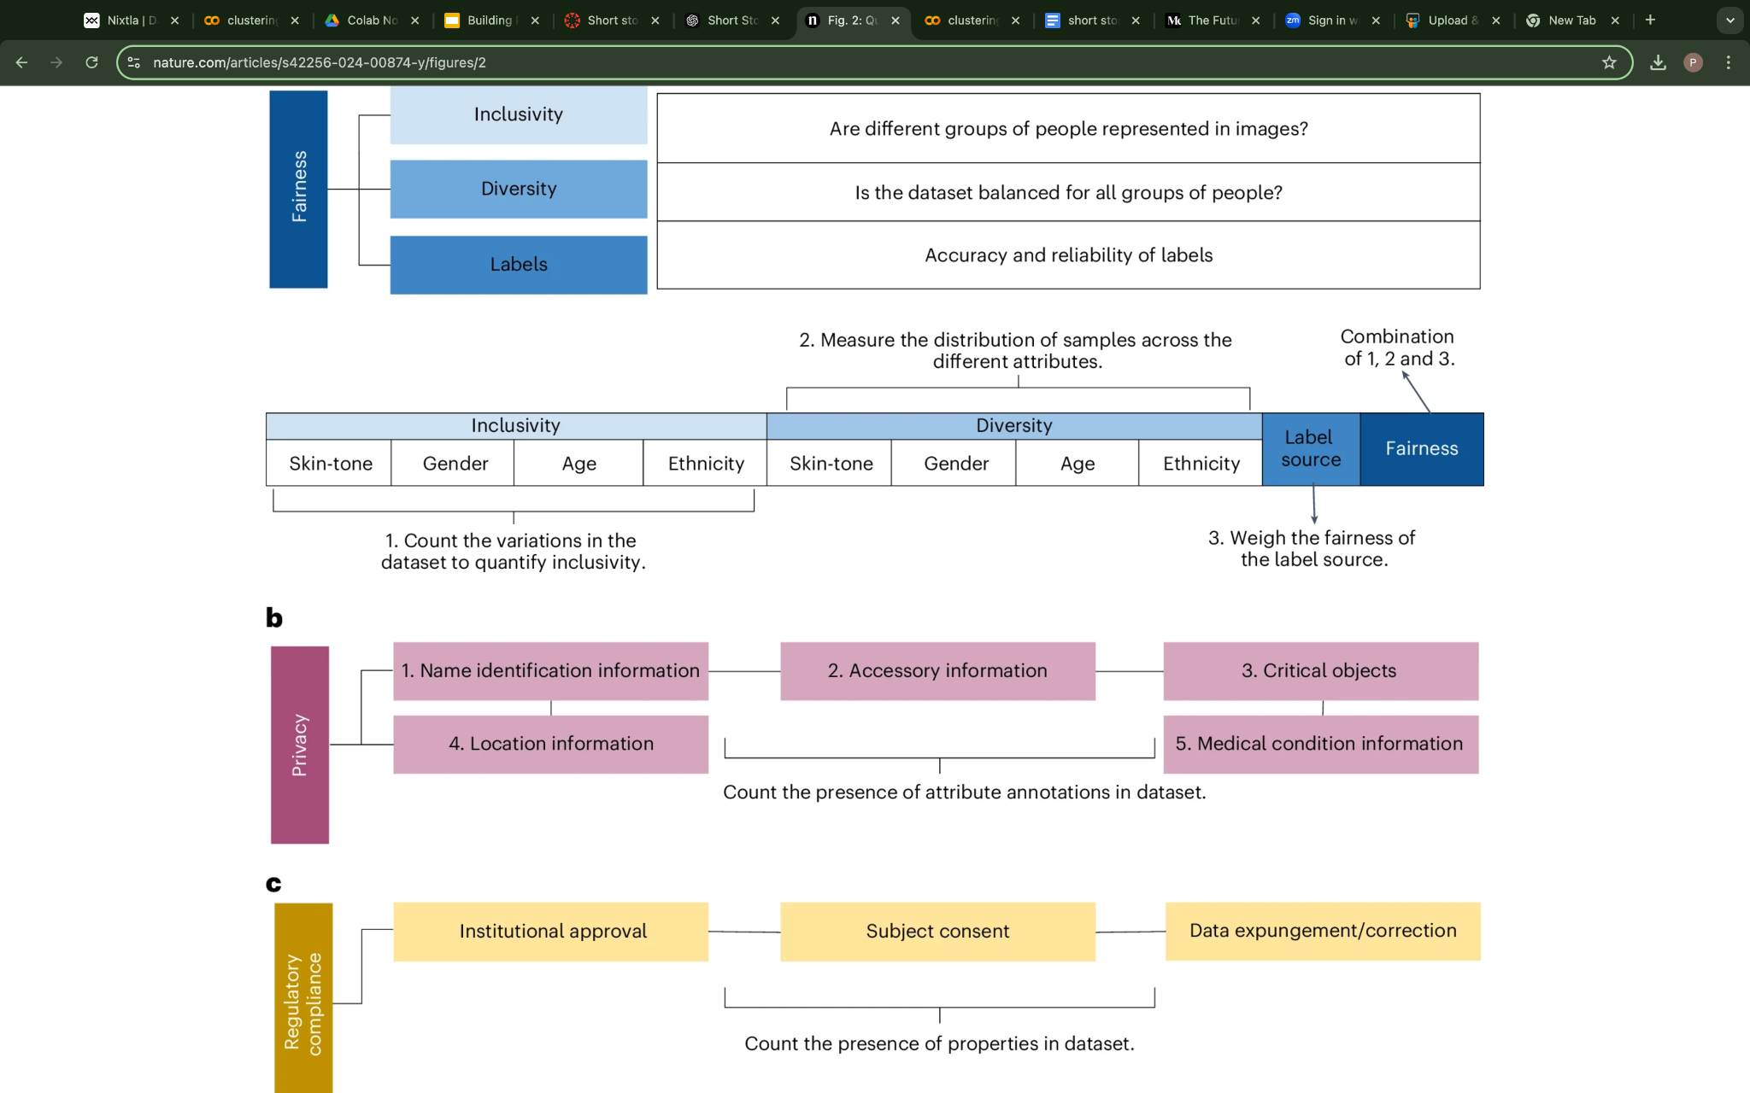
How is Fairness Measured?
Evaluated on:
Inclusivity: Gender, ethnicity, age representation.
Diversity: Balanced demographic distribution.
Label Reliability: Quality of labels(self-reported > automated).
Example: UTKFace dataset scored 2.71/5, the highest among evaluated datasets.
This framework evaluates fairness by quantifying inclusivity, measuring diversity, and assessing the reliability of labels to ensure balanced representation.

Slide 5
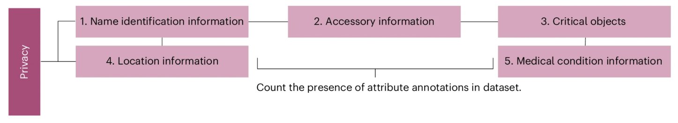
Protecting Privacy in Datasets
Sensitive Attribute Identification:Highlights data categories like names, locations, and medical details.
Data Masking:Ensures private attributes are de-identified or anonymized.
Critical Objects:Identifies sensitive accessory information (e.g., credit cards, documents).
Example: DroneSURF dataset scored 6/6 for privacy by excluding identifiable data.
Privacy is protected by identifying sensitive attributes, anonymizing data, and mitigating risks of exposure.

Slide 6
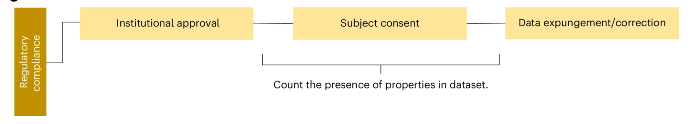
Regulatory Challenges
1.Institutional Approval: Validates dataset ethics through review boards.
2.Participant Consent: Ensures explicit agreement from individuals whose data is included.
3.Data Expungement: Allows participants to remove or correct their data upon request.
Regulatory compliance ensures datasets align with ethical and legal standards like GDPR and HIPAA.

Slide 7
Fairness vs. Privacy: A Paradox
Trade-offs:
Including sensitive attributes (e.g., race, gender) improves fairness metrics.
However, these attributes increase the risk of privacy violations.
Example: UTKFace dataset prioritizes fairness but raises privacy concerns.

Slide 8
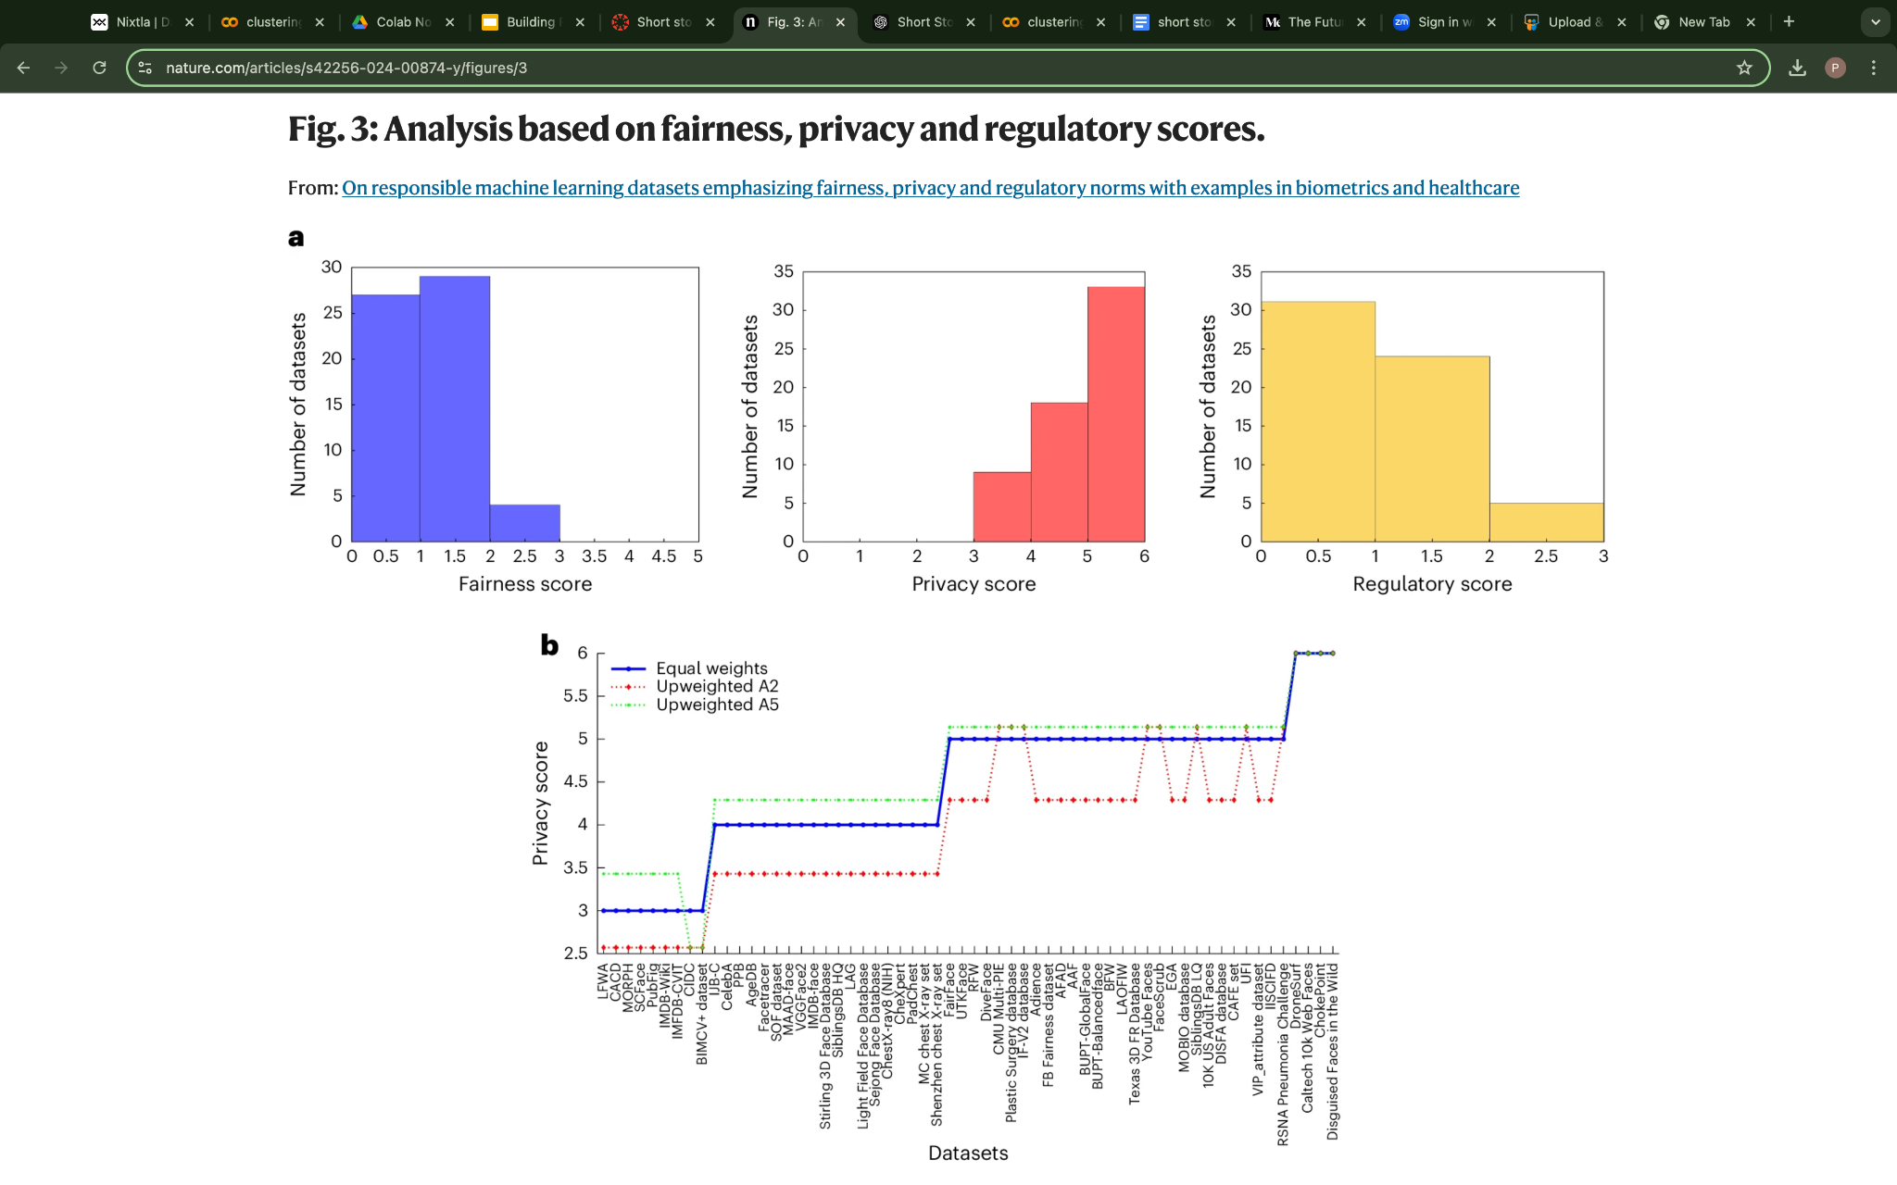
Evaluating Dataset Responsibility
Combined fairness, privacy, and compliance metrics create a responsibility score.
Key Observations:
Most datasets show low compliance.
Non-web-collected datasets, such as curated healthcare datasets, perform better overall in responsibility metrics.
This figure illustrates how privacy scores vary across datasets depending on the assigned weights for sensitive attributes.

Slide 9
Distribution of Dataset Metrics
Histograms display the distribution of fairness, privacy, and compliance scores, emphasizing the challenges in achieving responsible datasets.
Metric Distributions:
Fairness scores are generally below 3, reflecting gaps in demographic representation.
Privacy scores are more varied, with some datasets achieving high levels of protection.
Regulatory compliance remains low across most datasets, with many scoring under 1.

Slide 10
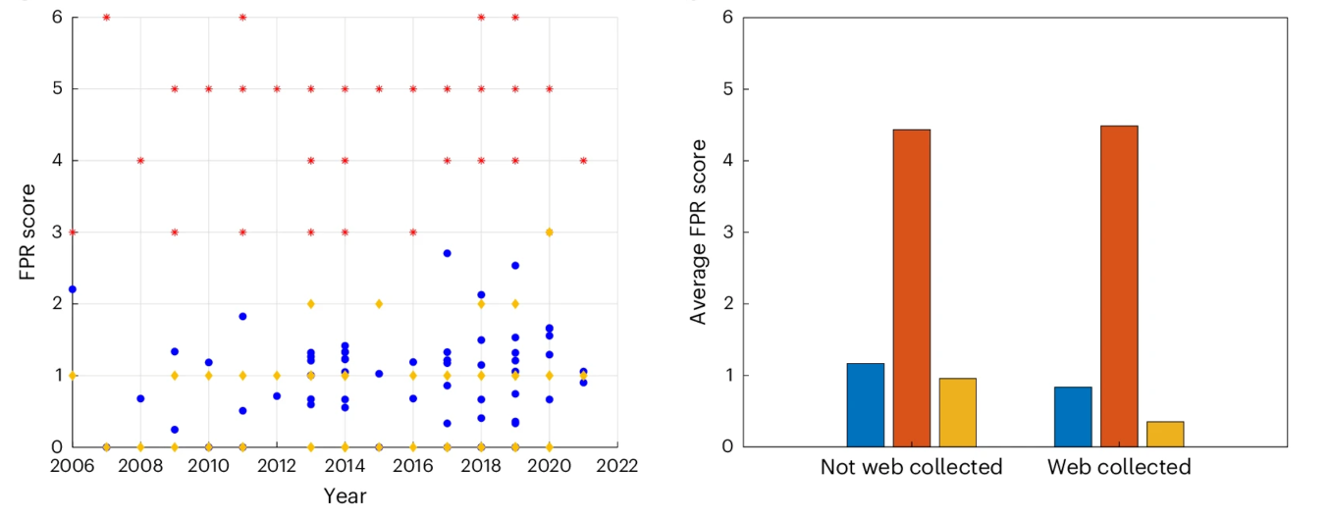
Dataset Trends and Insights
Trends over time reveal slight improvements in privacy but consistently low fairness scores.
Web-collected datasets show higher responsibility scores compared to non-web-collected datasets.
Fairness scores have remained consistently low over time, as shown in FPR trends.
Web-collected datasets outperform non-web-collected datasets in overall responsibility scores.

Slide 11
Guidelines for Responsible Dataset Creation
For Researchers:
Ethics review and institutional approval.
Create comprehensive datasheets documenting dataset limitations.
For Practitioners:
Use synthetic data for balancing fairness and privacy.
Provide mechanisms for user consent and data deletion.
Key Point: A systematic approach to dataset creation fosters trust and accountability.

Slide 12
Impact and Future Directions
Impact: Responsible datasets enhance ethical AI and reduce harm.
Future Work:
New tools for auditing fairness, privacy, and compliance.
Stricter enforcement of global regulations like GDPR and HIPAA.
Call to Action: Researchers and policymakers must collaborate to set standards.

Slide 13
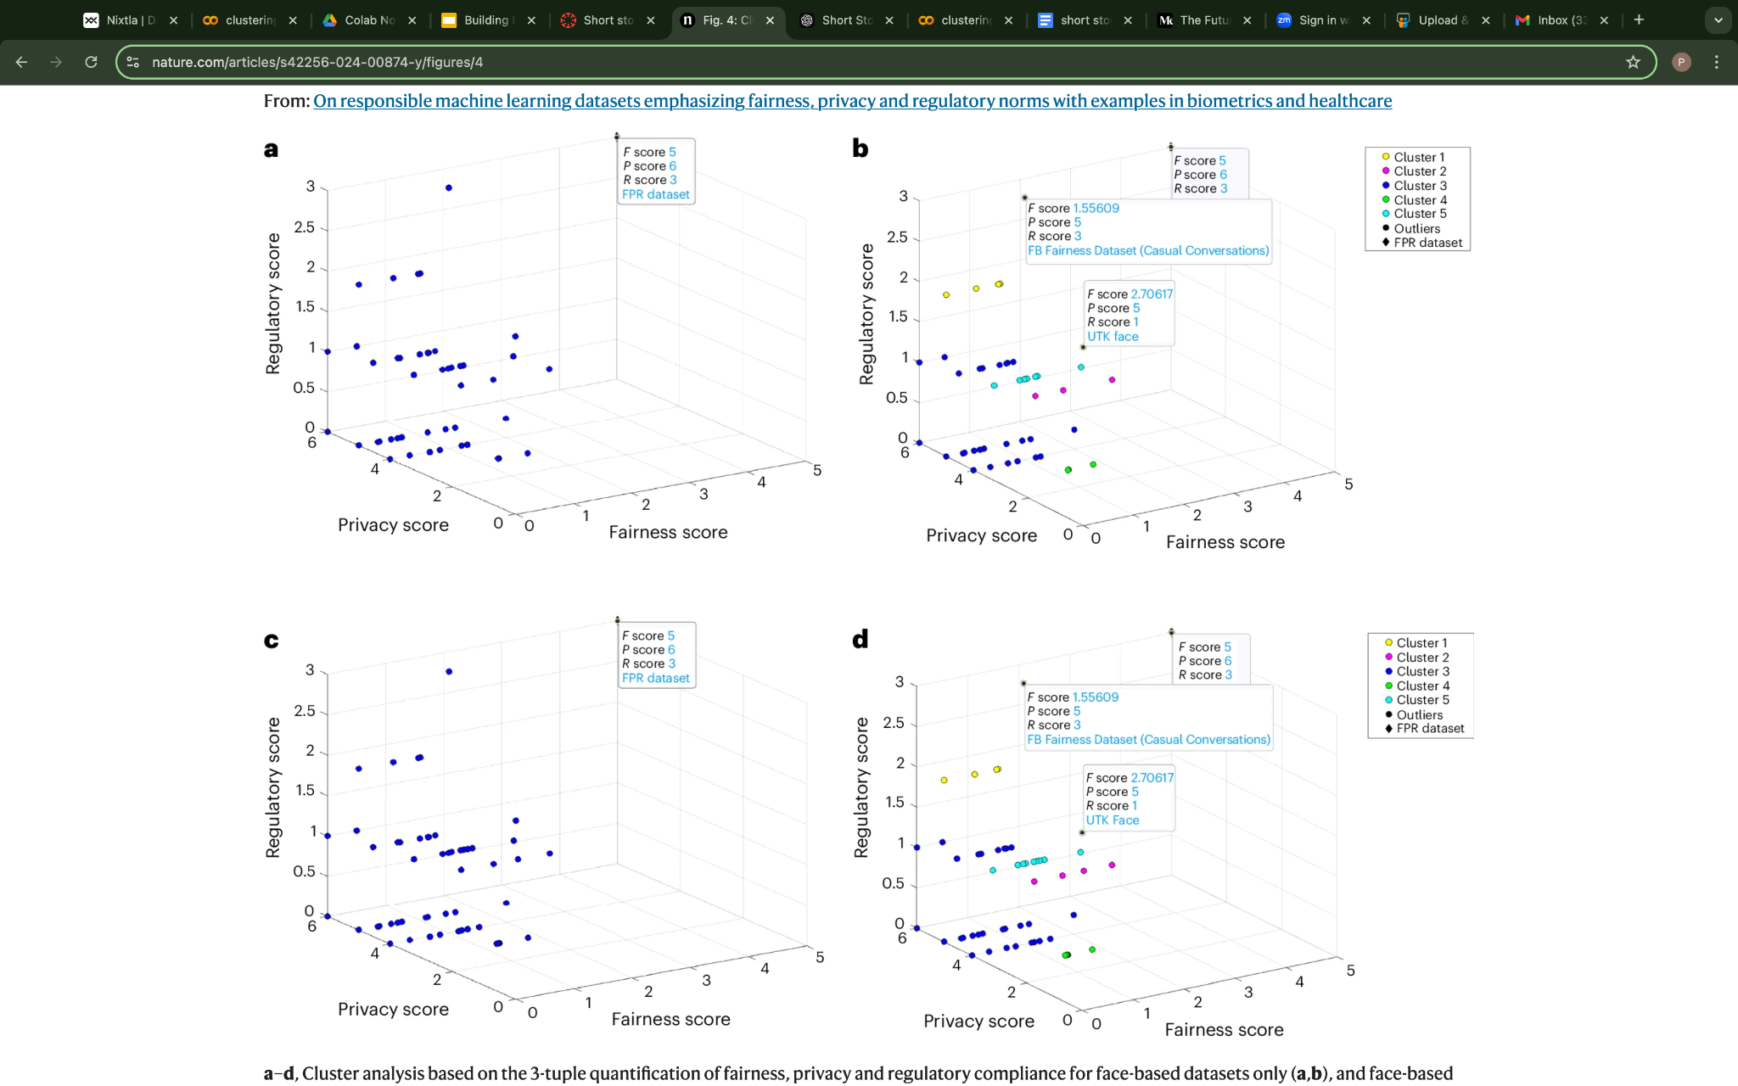
Takeaways
Fairness, Privacy, and Compliance Metrics:
The clusters highlight varying levels of dataset performance across the three dimensions.
Key Observation: Most datasets are clustered with low fairness and compliance scores, with privacy being the only metric showing significant variation.
Insights from Clusters:
Outliers: Datasets like UTKFace and FB Fairness stand out due to higher fairness and compliance scores.
General Trend: Web-collected datasets tend to have slightly better scores than non-web-collected ones.
Cluster-based analysis categorizes datasets based on their fairness, privacy, and compliance scores, revealing significant disparities and highlighting outliers like UTKFace.

Slide 14
References
Mittal, S., Thakral, K., Singh, R., Vatsa, M., Glaser, T., Canton Ferrer, C., & Hassner, T. (2024). On responsible machine learning datasets emphasizing fairness, privacy and regulatory norms. Nature Machine Intelligence. Link to Article
Gebru, T., Morgenstern, J., Vecchione, B., et al. (2018). Datasheets for Datasets. Link to Paper
General Data Protection Regulation (GDPR). Official Journal of the European Union. Website
U.S. Department of Health and Human Services. HIPAA Privacy Rule. Website
ECCV 2024 ABAW Challenge Datasets and Metrics. Website
Additional datasets: UTKFace, FB Fairness, DroneSURF, CelebA, ChestX-ray8.

